Slide 1
How Much of the Internet Is Fake? Turns out a Lot, Actually.
Original Article BY: Max ReAd, New York Magazine, 2018
Presented By: Matthew Stevenson
CS895 – Spring 2019
Source: http://nymag.com/intelligencer/2018/12/how-much-of-the-internet-is-fake.html

Slide 2
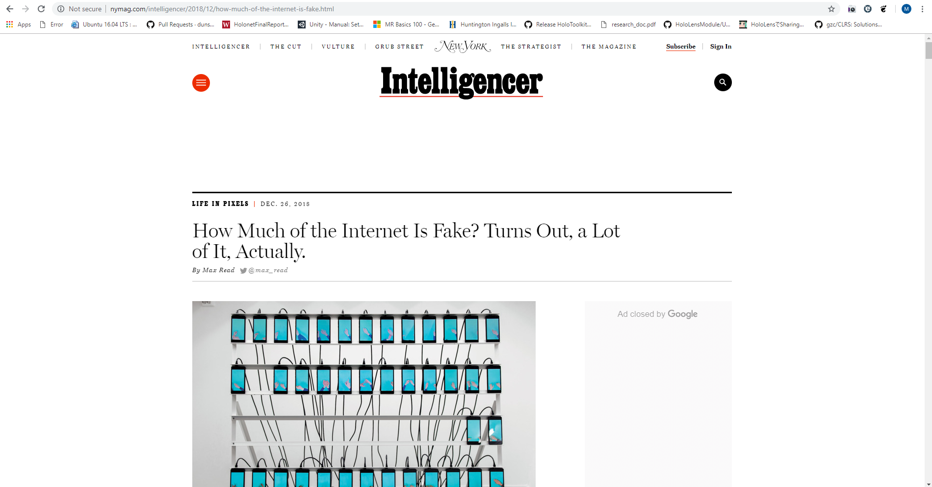
Source: http://nymag.com/intelligencer/2018/12/how-much-of-the-internet-is-fake.html

Slide 3
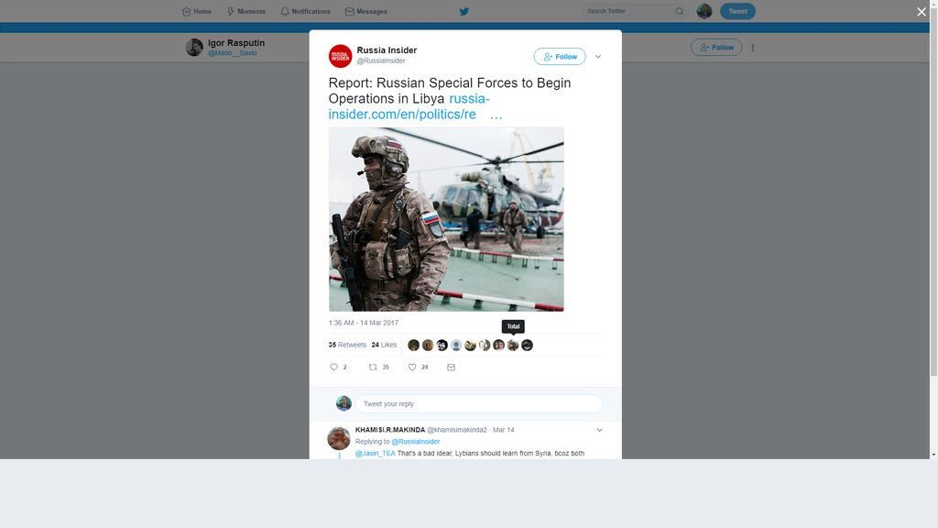
Source: https://twitter.com/malcolmnance/status/891699369564438528

Slide 4
“Studies generally suggest that, year after year, less than 60 percent of web traffic is human; some years, according to some researchers, a healthy majority of it is bot.”
- Max Read
Source: http://nymag.com/intelligencer/2018/12/how-much-of-the-internet-is-fake.html

Slide 5


Is the Internet only BotNets?
In late 2018, Digital ad fraud was recorded by the Justice Department in excess of $36 million dollars of damages due to 3ve technology and Methbot as the culprits.
Traffic was spoofed to appear that websites running ads were receiving “real” data by both 3ve and Methbot botnets.
The type of traffic includes:
Fake clicks
Mouse movements
Social network login information appear to be a real user
Source: http://nymag.com/intelligencer/2018/12/how-much-of-the-internet-is-fake.html

Slide 6
3ve Technology

Slide 7

What is 3ve technology?
“3ve (pronounced “Eve”) was a global, complex family of online fraud operations, each designed to evade detection.” – White Ops
Source: https://www.whiteops.com/3ve

Slide 8
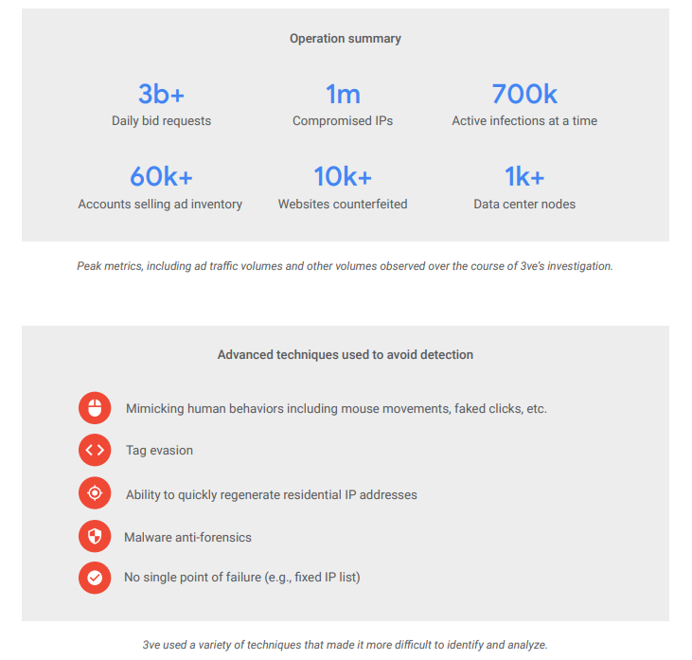
Effects of 3ve

Slide 9
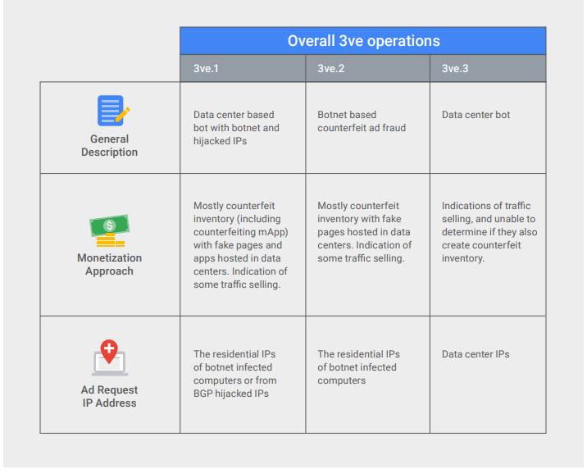
Source: https://services.google.com/fh/files/blogs/3ve_google_whiteops_whitepaper_final_nov_2018.pdf

Slide 10
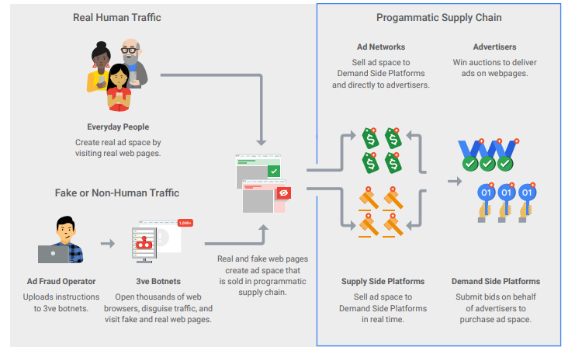
Source: https://services.google.com/fh/files/blogs/3ve_google_whiteops_whitepaper_final_nov_2018.pdf

Slide 11
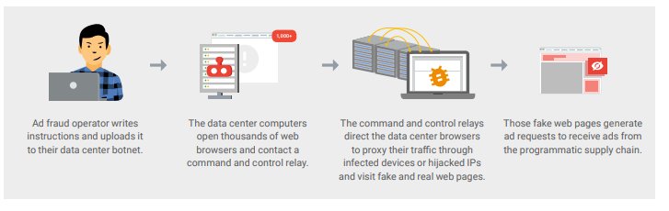
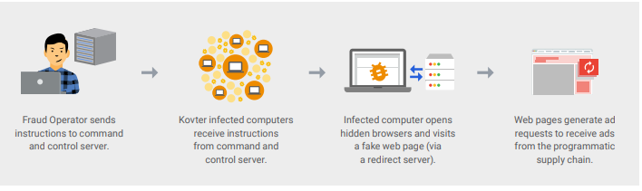
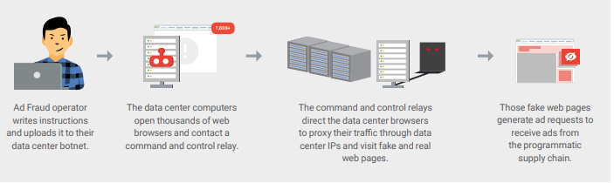
3v1
3v2
3v3
Source: https://services.google.com/fh/files/blogs/3ve_google_whiteops_whitepaper_final_nov_2018.pdf

Slide 12
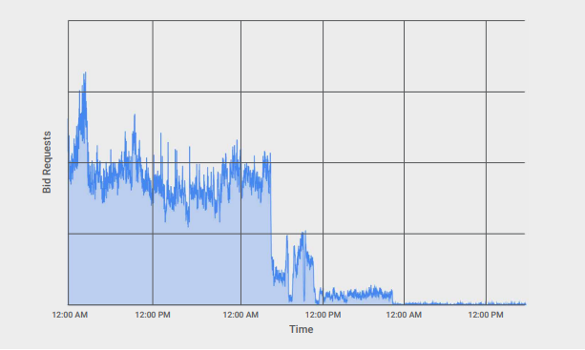
Source: https://services.google.com/fh/files/blogs/3ve_google_whiteops_whitepaper_final_nov_2018.pdf

Slide 13
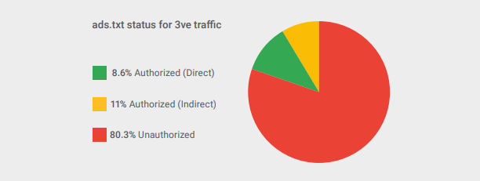
Source: https://services.google.com/fh/files/blogs/3ve_google_whiteops_whitepaper_final_nov_2018.pdf

Slide 14
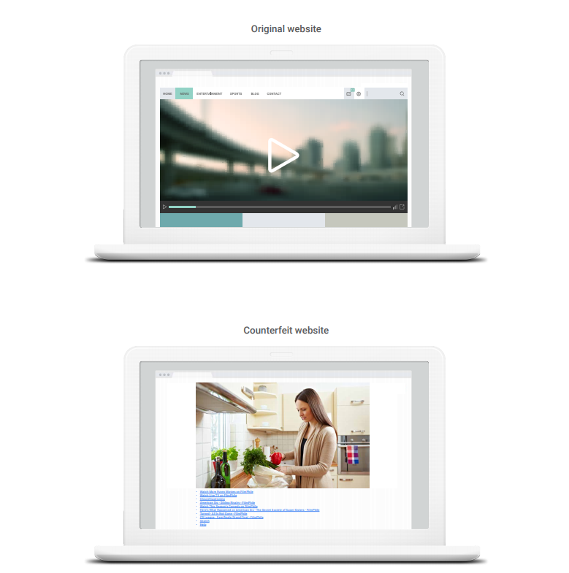
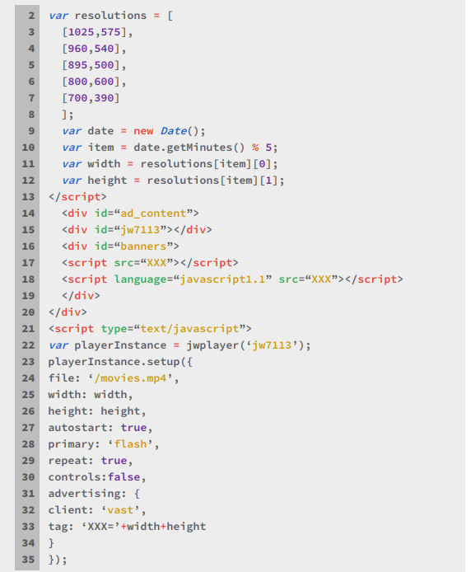
Fake website?
Source: https://services.google.com/fh/files/blogs/3ve_google_whiteops_whitepaper_final_nov_2018.pdf

Slide 15
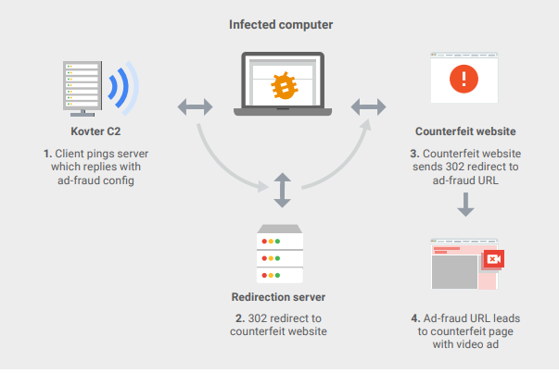
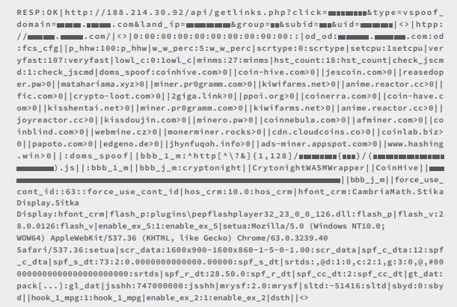
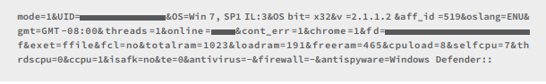
3v2 infected computer operations
Source: https://services.google.com/fh/files/blogs/3ve_google_whiteops_whitepaper_final_nov_2018.pdf

Slide 16
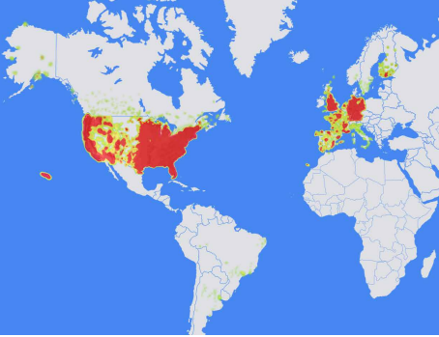
Area of infiltration for 3v2
Source: https://services.google.com/fh/files/blogs/3ve_google_whiteops_whitepaper_final_nov_2018.pdf

Slide 17
Methbot

Slide 18
Effects of Methbot
Source: https://cdn2.hubspot.net/hubfs/3400937/WO_Methbot_Operation_WP_01.pdf

Slide 19
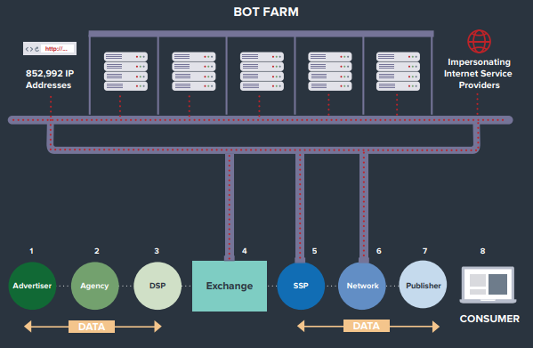
The Methbot Bot Farm
Source: https://cdn2.hubspot.net/hubfs/3400937/WO_Methbot_Operation_WP_01.pdf

Slide 20
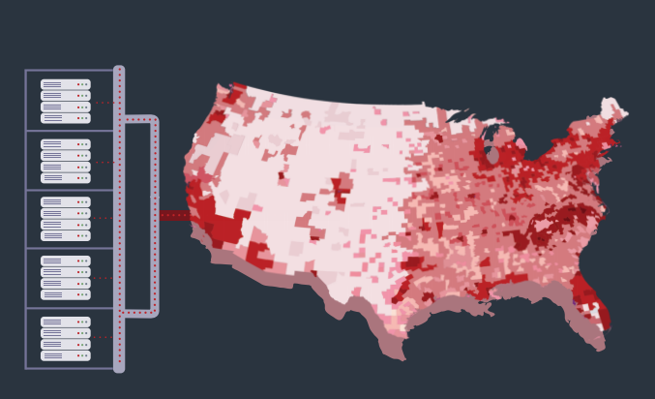
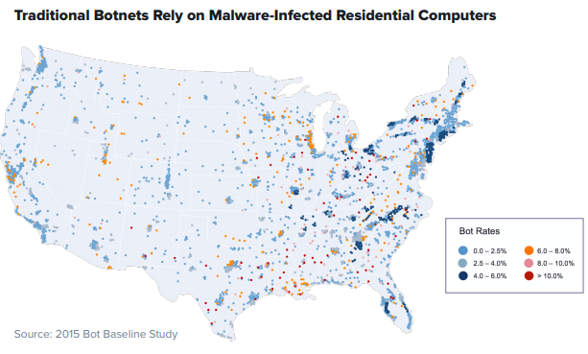
Heatmap Distribution of Methbot in Comparison to traditional Botnets
Source: https://cdn2.hubspot.net/hubfs/3400937/WO_Methbot_Operation_WP_01.pdf

Slide 21

Characteristics of Methbot
Preserve session data between executions
Parse html
Uses JWPlayer to run ad tags and request video advertisements
NodeJS
Source: https://cdn2.hubspot.net/hubfs/3400937/WO_Methbot_Operation_WP_01.pdf

Slide 22
Key Behaviors
Counterfeit pages
Offer Inventory
Produce Fake views and clicks
Source: https://cdn2.hubspot.net/hubfs/3400937/WO_Methbot_Operation_WP_01.pdf

Slide 23
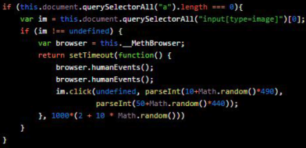
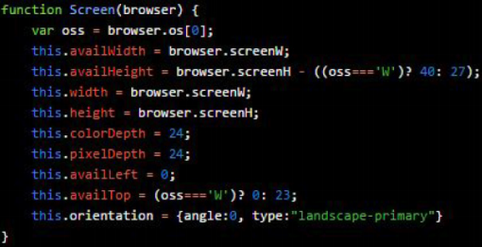
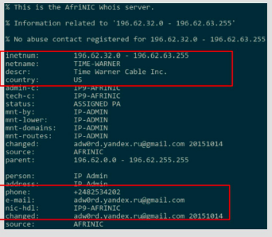
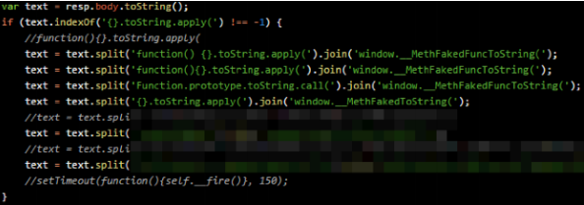
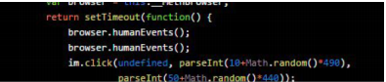
Avoidance of Fraud Detection
Screen object construction
Dynamic Code Patching
Spoofing Behaviors
Human Input Simulation
Forged IP Registration
Source: https://cdn2.hubspot.net/hubfs/3400937/WO_Methbot_Operation_WP_01.pdf

Slide 24
Why Should We Be Concerned?

Slide 25
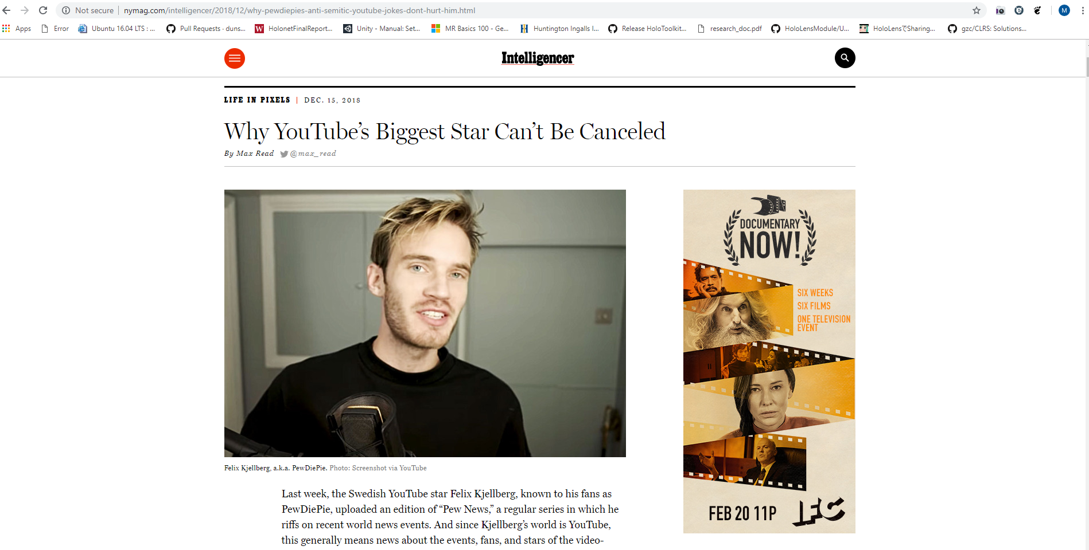
PewDiePie?
Source: http://nymag.com/intelligencer/2018/12/why-pewdiepies-anti-semitic-youtube-jokes-dont-hurt-him.html

Slide 26
We have reached an Inversion Point…
It is concerning to know that web traffic is highly saturated with botnet traffic. This is problematic due to machine learning algorithms that are used to detect fraudulent activity are being bypassed by this sophisticated types of botnet activity.
At some point, efforts to detect fraudulent activity would be difficult to determine the validity of content because machine learning would recognize both botnet traffic and human traffic as real or, even consider humans the outlier.
This is known as the hypothetical event called “The Inversion.”
Source: http://nymag.com/intelligencer/2018/12/how-much-of-the-internet-is-fake.html

Slide 27
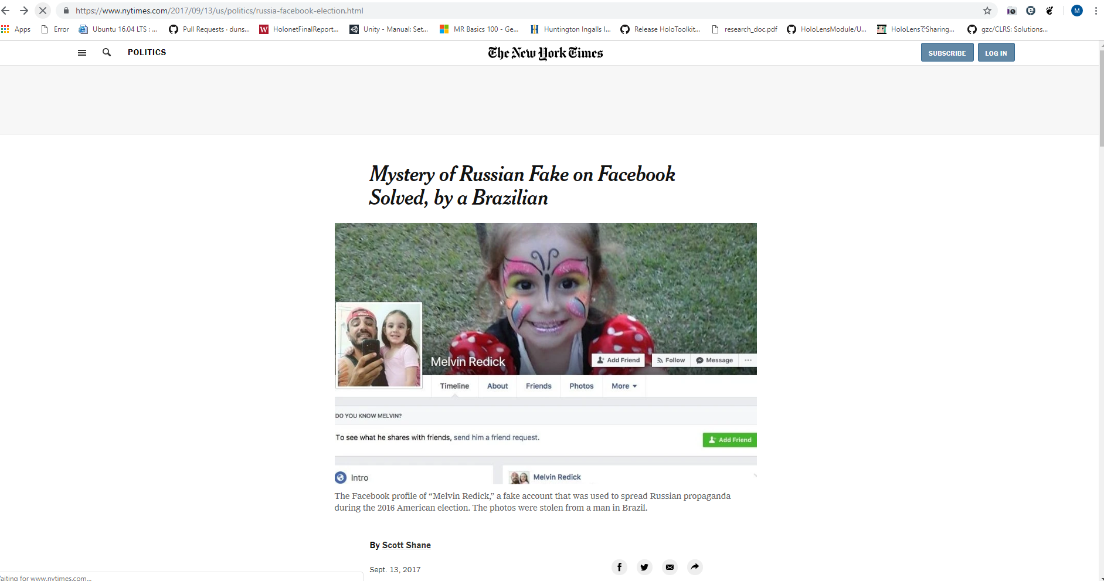
Source: https://www.nytimes.com/2017/09/13/us/politics/russia-facebook-election.html

Slide 28
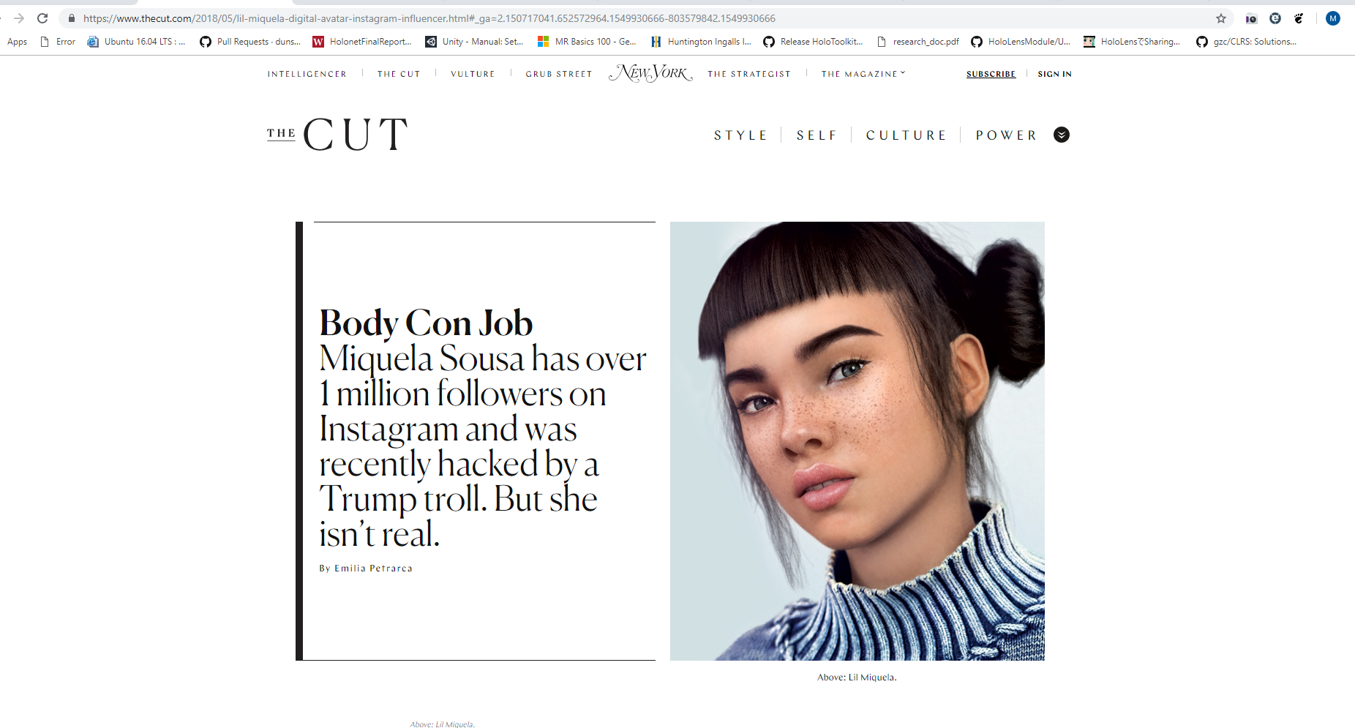
Source: https://www.nytimes.com/2017/09/13/us/politics/russia-facebook-election.html

Slide 29
Closing Remarks
JavaScript is bad. Botnets are bad.

